Slide 1
SECURE DATA HIDING IN IMAGES USING STEGANOGRAPHY
CAPSTONE PROJECT
Presented By: Ujjwal Singh
Student Name : Ujjwal Singh
College Name & Department : Atria Institute of Technology (Computer Science and Engineering)

Slide 2
OUTLINE
Problem Statement
Technology used
Wow factor
End users
Result
Conclusion
Git-hub Link
Future scope

Slide 3
Problem Statement
Secure communication is crucial to protect sensitive data from unauthorized access. Traditional encryption methods often require complex keys and external files, making them less user-friendly. This project implements image-based steganography, embedding a secret message within an image’s pixel values. The encrypted image can be shared securely, and only users with the correct passcode can retrieve the hidden message, ensuring confidentiality.

Slide 4
Technology used
Programming Language: Python
Libraries: OpenCV (cv2 for image processing), OS (os for file operations)
Platforms: Windows, Linux, macOS (Python-compatible OS)
File Formats: PNG (lossless encryption), TXT (passcode storage)

Slide 5
Wow factors
Image-Based Steganography: Hides messages within pixel values instead of traditional text-based encryption.
No External Key File Needed: The passcode is required only for decryption, eliminating key management complexities.
Lossless Encryption with PNG: Ensures message integrity without distortion or compression artifacts.
Lightweight & Fast: Uses simple pixel manipulation, making it efficient and easy to implement.
Cross-Platform Compatibility: Works on Windows, Linux, and macOS with minimal dependencies.

Slide 6
End users
Journalists & Activists – Securely communicate in restrictive environments without attracting suspicion.
Cybersecurity Enthusiasts – Learn and experiment with steganography techniques for data security.
Forensic & Intelligence Agencies – Hide and retrieve confidential messages in digital investigations.
General Users – Protect personal information and messages from unauthorized access.
Developers & Researchers – Explore encryption techniques and enhance privacy-focused applications.

Slide 7
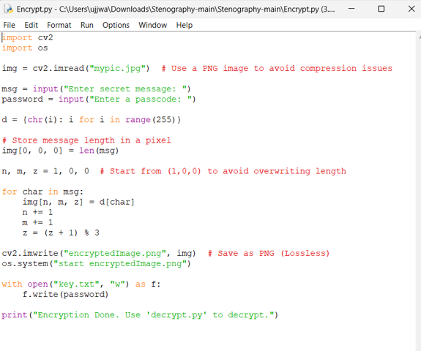
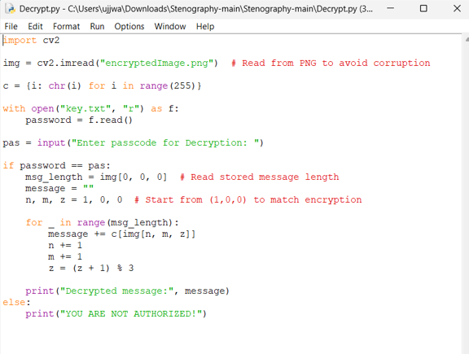
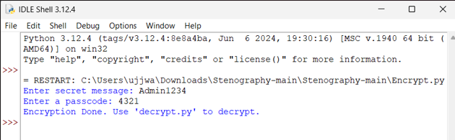
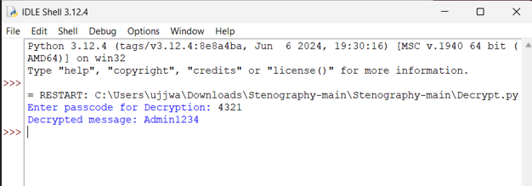
Results

Slide 8
Conclusion
This project successfully addresses the need for secure and hidden communication by leveraging image-based steganography. Unlike traditional encryption methods, it embeds secret messages within image pixels, making detection difficult while ensuring confidentiality. By using lossless PNG storage, it preserves data integrity and prevents corruption. The system is lightweight, cross-platform, and user-friendly, making it accessible to a wide range of users for secure communication.

Slide 9
GitHub Link
https://github.com/UjjwallS/AICTE-Project-Cyber-Security-.git

Slide 10
Future scope(optional)
Advanced Encryption – Implement stronger encryption algorithms before embedding the message for added security.
Adaptive Steganography – Use AI to dynamically adjust pixel modifications to make detection even harder.
Mobile App Integration – Develop an Android/iOS app for easy encryption and decryption on smartphones.
Cloud-Based Secure Messaging – Enable encrypted image sharing through a secure cloud platform.
Steganalysis Resistance – Enhance techniques to evade steganalysis tools used for detecting hidden messages.

Slide 11
THANK YOU

